Slide 1
Scanpy ScRNA Clustering

Slide 2
Angiotensin Converting Enzyme 2 (ACE2) may be a potential indicator of COVID infection risk
•COVID19 poses a great burden to public health and economy
•Many patients have non-respiratory symptoms and long-term multiple organ damages
•ACE2 is the receptor for COVID19
•ACE inhibitor and angiotensin receptor blocker prescriptions were associated with a reduced risk of COVID-19 in a very large population-based study
•ACE2 is the integral part of the renin-angiotensin-aldosterone system (RAAS) that regulates blood pressure
•ACE2 has been found in the heart, lung, kidney, and other organs
•The cell types and organs that express ACE2 as a potential receptor for COVID are still unclear

Slide 3
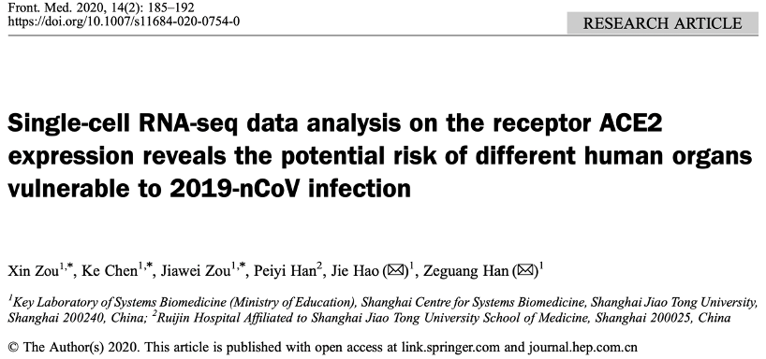
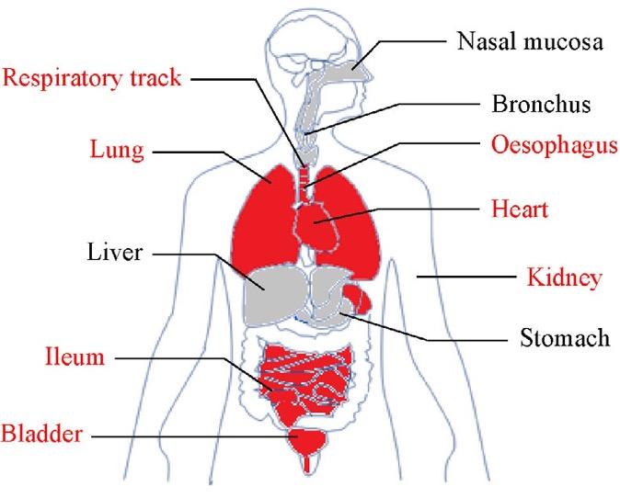


Identification of COVID infection risk in multiple organs using scRNA-Seq data

Slide 4
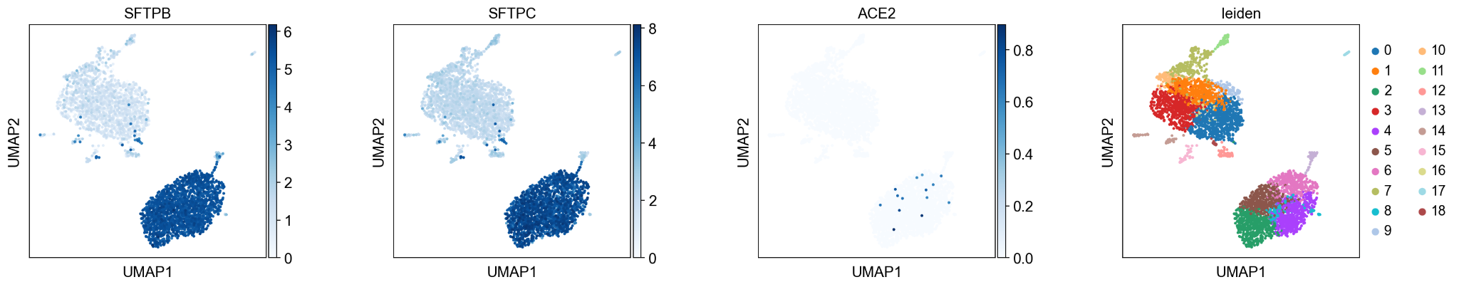
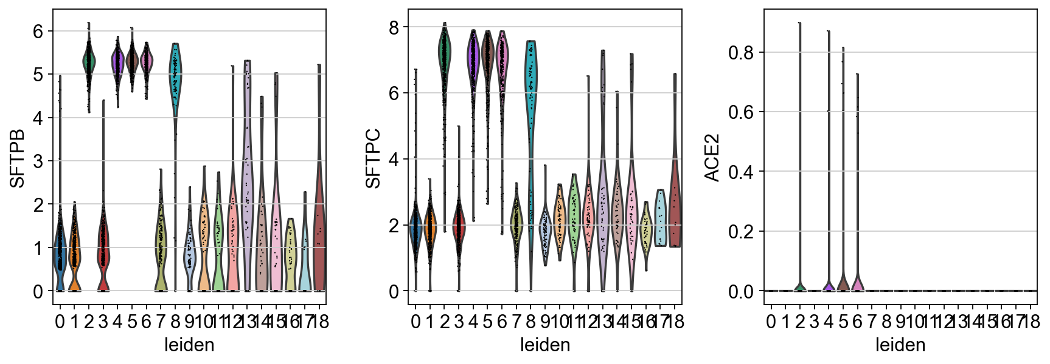
Results - Lungs

Slide 5
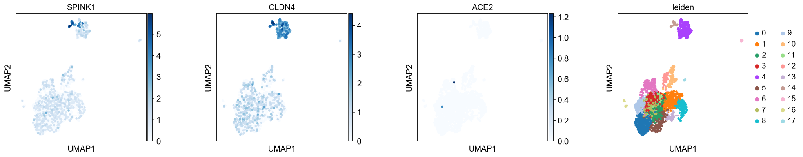
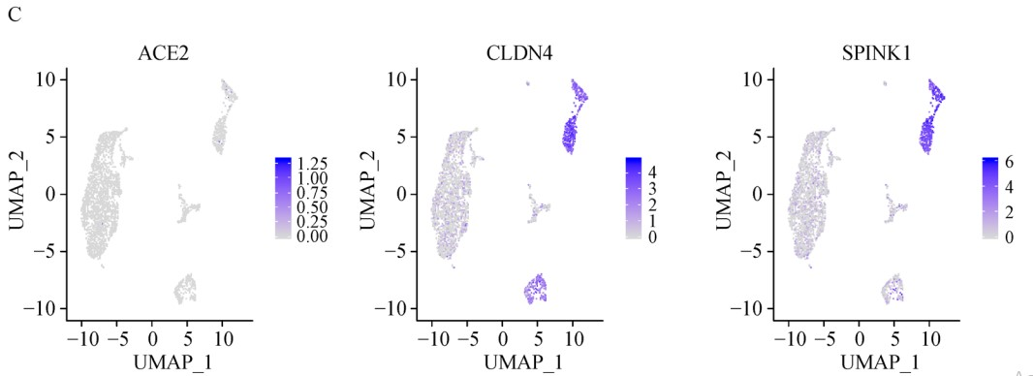
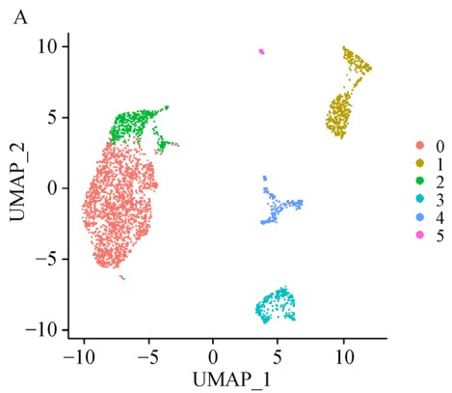
Results - Bladder
Our Results
Paper Results

Slide 6
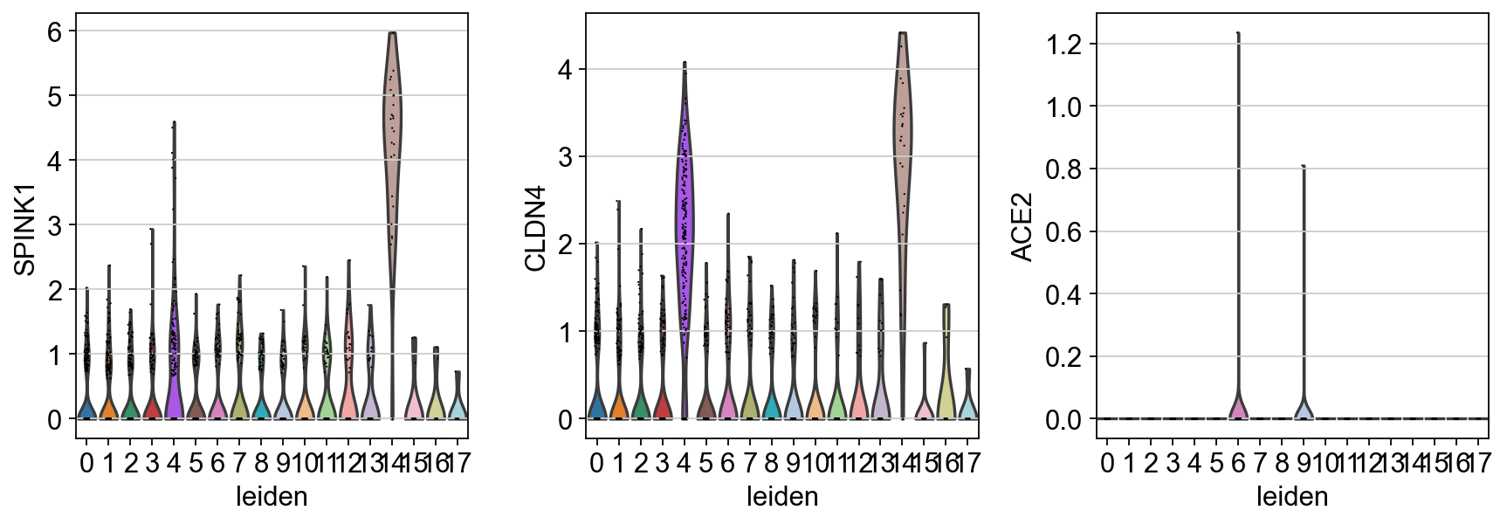
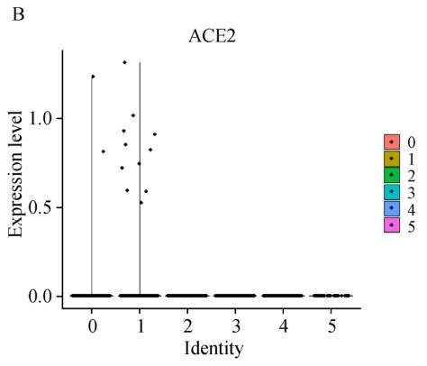
Results - Bladder
Our Results
Paper Results

Slide 7
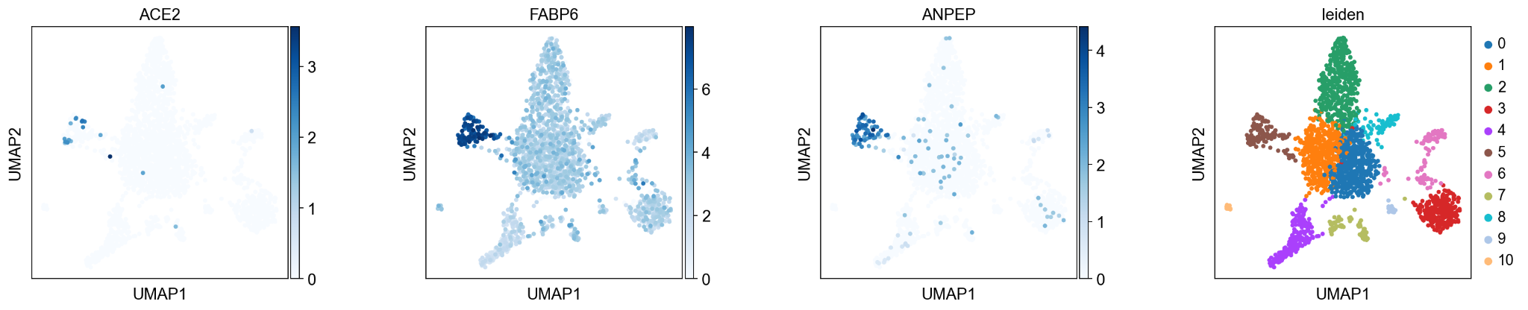
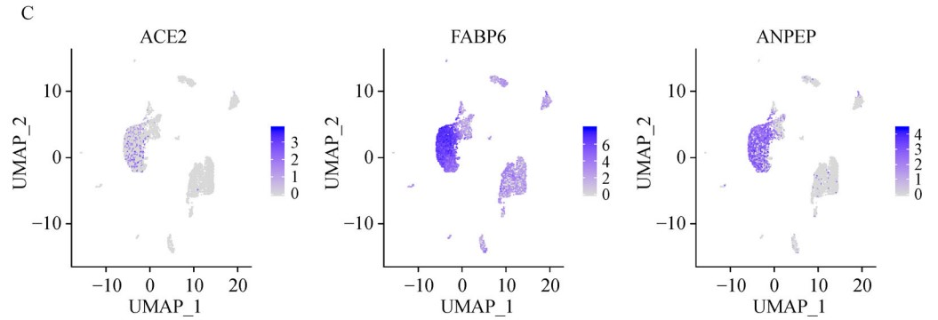
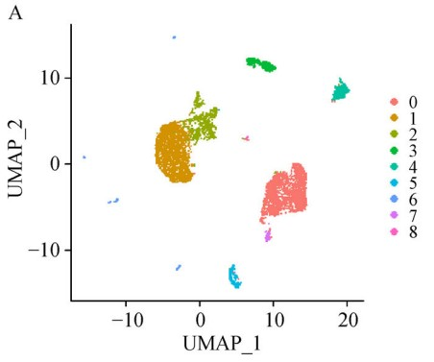
Results - Ileum
Our Results
Paper Results

Slide 8
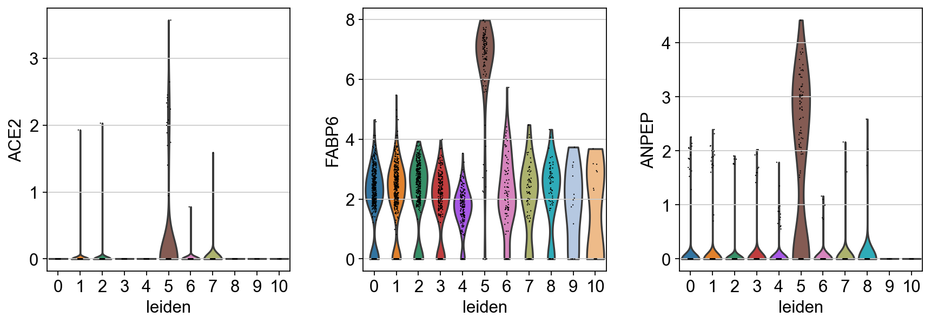
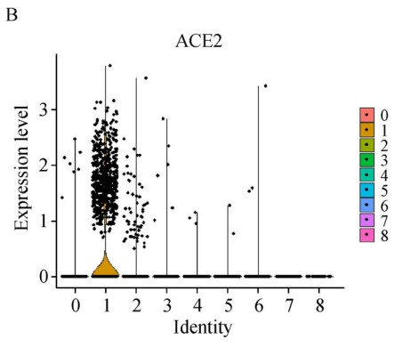
Results - Ileum
Our Results
Paper Results

Slide 9
Challenges
Datasets from each organ had different formats and converting them into Anndata required different functions or required a particular format
e.g. .mtx vs. .h5
e.g. Heart dataset was in a normalized count matrix .txt format that was not readable
Reproducibility of the article’s results
The original article (uses R package Seurat) did not provide specific information about its filtering thresholds and clustering algorithm
Reproducibility of UMAP figures
For some reason, we did not get exactly the same UMAP every time

Slide 10
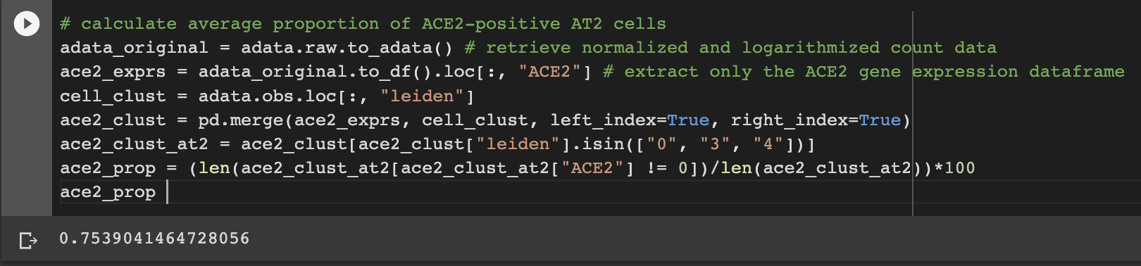
Challenges
4) Requires understanding of Anndata attributes and functions to operate correctly
e.g. retrieving logarithmized data from adata after clustering (.raw attribute and .to_adata())
5) Collating codes for all organs in a single Colab notebook

Slide 11
Thank You

